Slide 1

Stock Price Prediction using Sentiment Analysis and Deep Learning for Indian Markets
PUDUCHERRY TECHNOLOGICAL UNIVERSITY
GUIDED BY
DR. Dr. Salini P
DEPARTMENT-CSE
PUDUCHERRY TECHNOLOGICAL UNIVERSITY
Submitted by
SAURABH KISHOR (19CS1100)
SHUBHAM CHOUDHURY(19CS1103)
UTKARSH(19CS1113)

Slide 2
Abstract
Our aimed to predict the future stock movement of shares using the historical prices aided with availability of sentiment data. Two models were used as part of the exercise, LSTM was the first model with historical prices as the independent variable. Sentiment Analysis captured using Intensity Analyzer was used as the major parameter for Random Forest Model used for the second part, some macro parameters like Gold, Oil prices, USD exchange rate and Indian Govt. Securities yields were also added to the model for improved accuracy of the model.

Slide 3
INTRODUCTION
Stock market trends are extremely volatile in nature that makes prediction quite hard. In this project we predict future stock prices using Machine Learning and other Artificial Intelligence.
Prediction of stock market trends with high accuracy generates significant revenue. Fundamental and technical analyses are two basic approaches used for stock trend prediction. Technical analysis inspects past data and volumes of stock prices while fundamental analysis stock statistics , evaluates industry’s performance, political events, and economic circumstances.

Slide 4
Objective
The objective is to predict the stock prices in order to make more informed and accurate investment decisions. We propose a stock price prediction system that integrates mathematical functions, machine learning, and other external factors for the purpose of achieving better stock prediction accuracy and issuing profitable trades. In this project, LSTM model and sentiment analysis is used to predict the stock price.

Slide 5
Problem Definition
The stock market allows investors to own shares of public companies through trading either by exchange or over the counter markets.
This market has given investors the chance of gaining money and having a prosperous life through investing small initial amounts of money, low risk compared to the risk of opening new business or the need of high salary career.
Stock markets are affected by many factors causing the uncertainty and high volatility in the market.
Stock market is a typical area that presents time-series data.
Stock prices are volatile in nature and price depends on various factors. The main aim of this project is to predict stock prices using Long short term memory (LSTM).

Slide 6
OBJECTIVE
Our objective is to predict the future price and calculate the future growth of the company in the different time span.
Then we analyze the prediction error for each company of different sector. Based on that we conclude which time span is best for future prediction of
that particular sector.
We first predict the future closing price of 5 different companies from some
predecided sectors with the help of LSTM(Long Short-Term Memory). This prediction will be done on historical data & the future prediction will be done for 3-month, 6- month, 1 year & 3 years. In these four different time spans (3 & 6 months, 1 & 3 years), we calculate the growth of those companies. Then by analyzing the deviations of closing price for each time span, we took the resultant time span which has maximum growth, i.e. less error for the particular sector

Slide 7
LITERATURE SURVEY
Reference | Data Source | Numerical Data | Textual Data | Prediction Techniques | Evaluation metrics
Ding et al. (2016) | S&P 500 through Yahoo Finance, News articles from Reuter’s website from October 2006, to November 2013 | Stock price data | Knowledge driven event embedding (KGEB) | KGEB-CNN | Accuracy = 66.93%
Vargas, De Lima & Evsukoff (2017) | S&P 500 index series are obtained through Yahoo Finance, News articles from Reuter’s website from 20-10-2006, to 2-11-2013 | Technical data | Word embedding and sentence embedding | Combines LSTM with CNN | Accuracy for word embedding and technical indicator = 61% Accuracy for sentence embedding and technical indicator = 62%
Chen et al. (2019) | Tokyo Stock Price Index (TOPIX), Financial news from Reuters | Stock price data | Proposed financial event dictionary, fine grained event using dictionary | Structured Stock Prediction Model(SSPM), Multi-Task Structured Stock Prediction Model(MSSPM) Using BiLSTM, self-attention and Conditional Random Fields (CRF) etc. | SSPM Accuracy = 66.4% MSSPM Accuracy = 65.7
Deng et al. (2019) | DJIA index from 08/08/2008 to 01/01/2016. Stock price data from Yahoo Finance, news headlines from Reddit WorldNews Channel | Stock price data | Knowledge driven event embedding | Knowledge Driven Temporal Convolutional Network (KDTCN) | Accuracy = 71.8%

Slide 8
  EXISTING METHODS
(Reff: International Journal of Advanced Research in Computer and Communication Engineering Vol. 8, Issue 1, January 2019)
In existing literature, two types of machine learning techniques are used for stock trend prediction.
Shallow learning is a machine learning technique: where composition layers are few like Support Vector Machine (SVM) and Artiﬁcial Neural Network (ANN).
Deep learning technique: contains many hidden layers like Convolutional Neural Network (CNN). The elegance of deep learning is to extract features and learn classiﬁcation

Slide 9
  Using Technique
Automated Stock Price Prediction Using Machine Learning
In this work, Our propose an automated trading system that integrates mathematical functions, machine learning, and other external factors such as news’ sentiments for the purpose of achieving better stock prediction accuracy and issuing profitable trades.
Particularly, Our aim to determine the price or the trend of a certain stock for the coming end-of-day considering the first several trading hours of the day. To achieve this goal, we trained traditional machine learning algorithms and created/trained multiple deep learning models taking into consideration the importance of the relevant news
Automated trading systems (ATS) that are operated by the implementation of computer programs can perform better and with higher momentum in submitting orders than any human.

Slide 10
OVERALL LIMITATION
This approach might have a limitation that, a strong positive/negative sentiment of a single news might be tempered down due to several neutral news thus resulting a neutral sentiment for the day.
Another limitation, part data and part solution is regarding computation of daily sentiment as indicated in the model description part, the approach used has been concatenation of all news data related to a single day and then calculating the sentiment cloud.
One of the limitations that was faced during the exercise was the use of Random Forest Regressor for Sentiment Analysis. As was observed in the first part of study, LSTM performs better than Random Forest Regressor when used for predictions using close price. Few attempts were made to try and use Multivariate LSTM to capture sentiment data along with close prices but much success couldn’t be achieved regarding implementation of the same.

Slide 11
  PROPOSED WORK
The prediction methods can be roughly divided into two categories,
statistical methods and artificial intelligence methods.
Statistical methods : It include logistic regression model, ARCH model, etc.
Artificial intelligence methods: It include multi-layer perceptron, convolutional neural network, naive Bayes network, back propagation network, single-layer LSTM, support vector machine, recurrent neural network, etc. They used Long short-term memory network (LSTM).

Slide 12
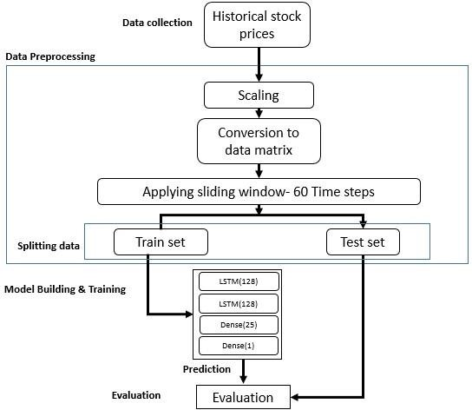
    Proposed Work
    SYSTEM ARCHITECTURE
Block diagram of stock prediction using LSTM

Slide 13
LSTM
LSTM including Bidirectional-LSTM were tried to predict stock prices through us- age of Historical Close price values. Hyper parameter tuning was also carried out to arrive at the optimum results.
As indicated in the table below, LSTM is performing better as compared to other mod- els tried as part of the study. Thus, LSTM was selected for prediction of stock prices for other companies as well viz., HDFC Bank, SBI and TCS.
Models | RMSE
LSTM | 38.19
Bidirectional LSTM | 184.29
Linear Regression | 1030.83
Arima | 532.64
KNN | 1273.05
Prophet | 311.46
Random Forest Regressor | 580.49

Slide 14
Sentiment analysis
Sentiment analysis using News Headlines was carried out as the next step of the exer- cise. An attempt was made the sentiments of news data. Polarity score for each daily news i.e. Positive, Negative, Neutral & Compound values were calculated using Inten- sity Analyzer. The results were not meeting our expectations as higher RMSE values were observed. Further tuning of the model was carried out by adding other parameters viz., Gold, Brent, G-sec and USD/INR exchange rate. There was a marked improve- ment in model predictions with the addition of these parameters.

Slide 15
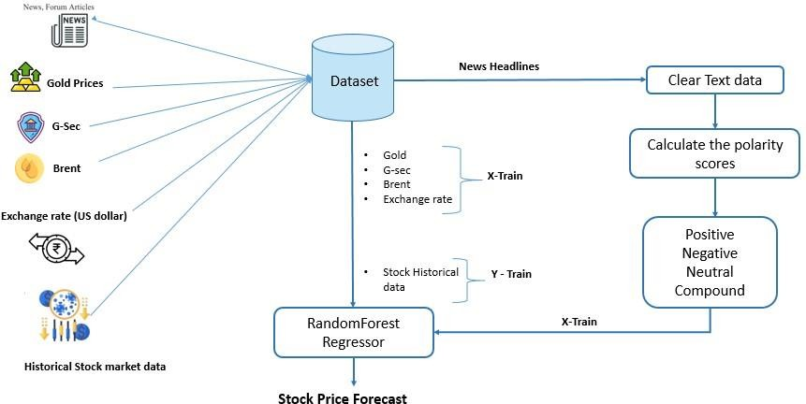
Block diagram of sentiment analysis

Slide 16
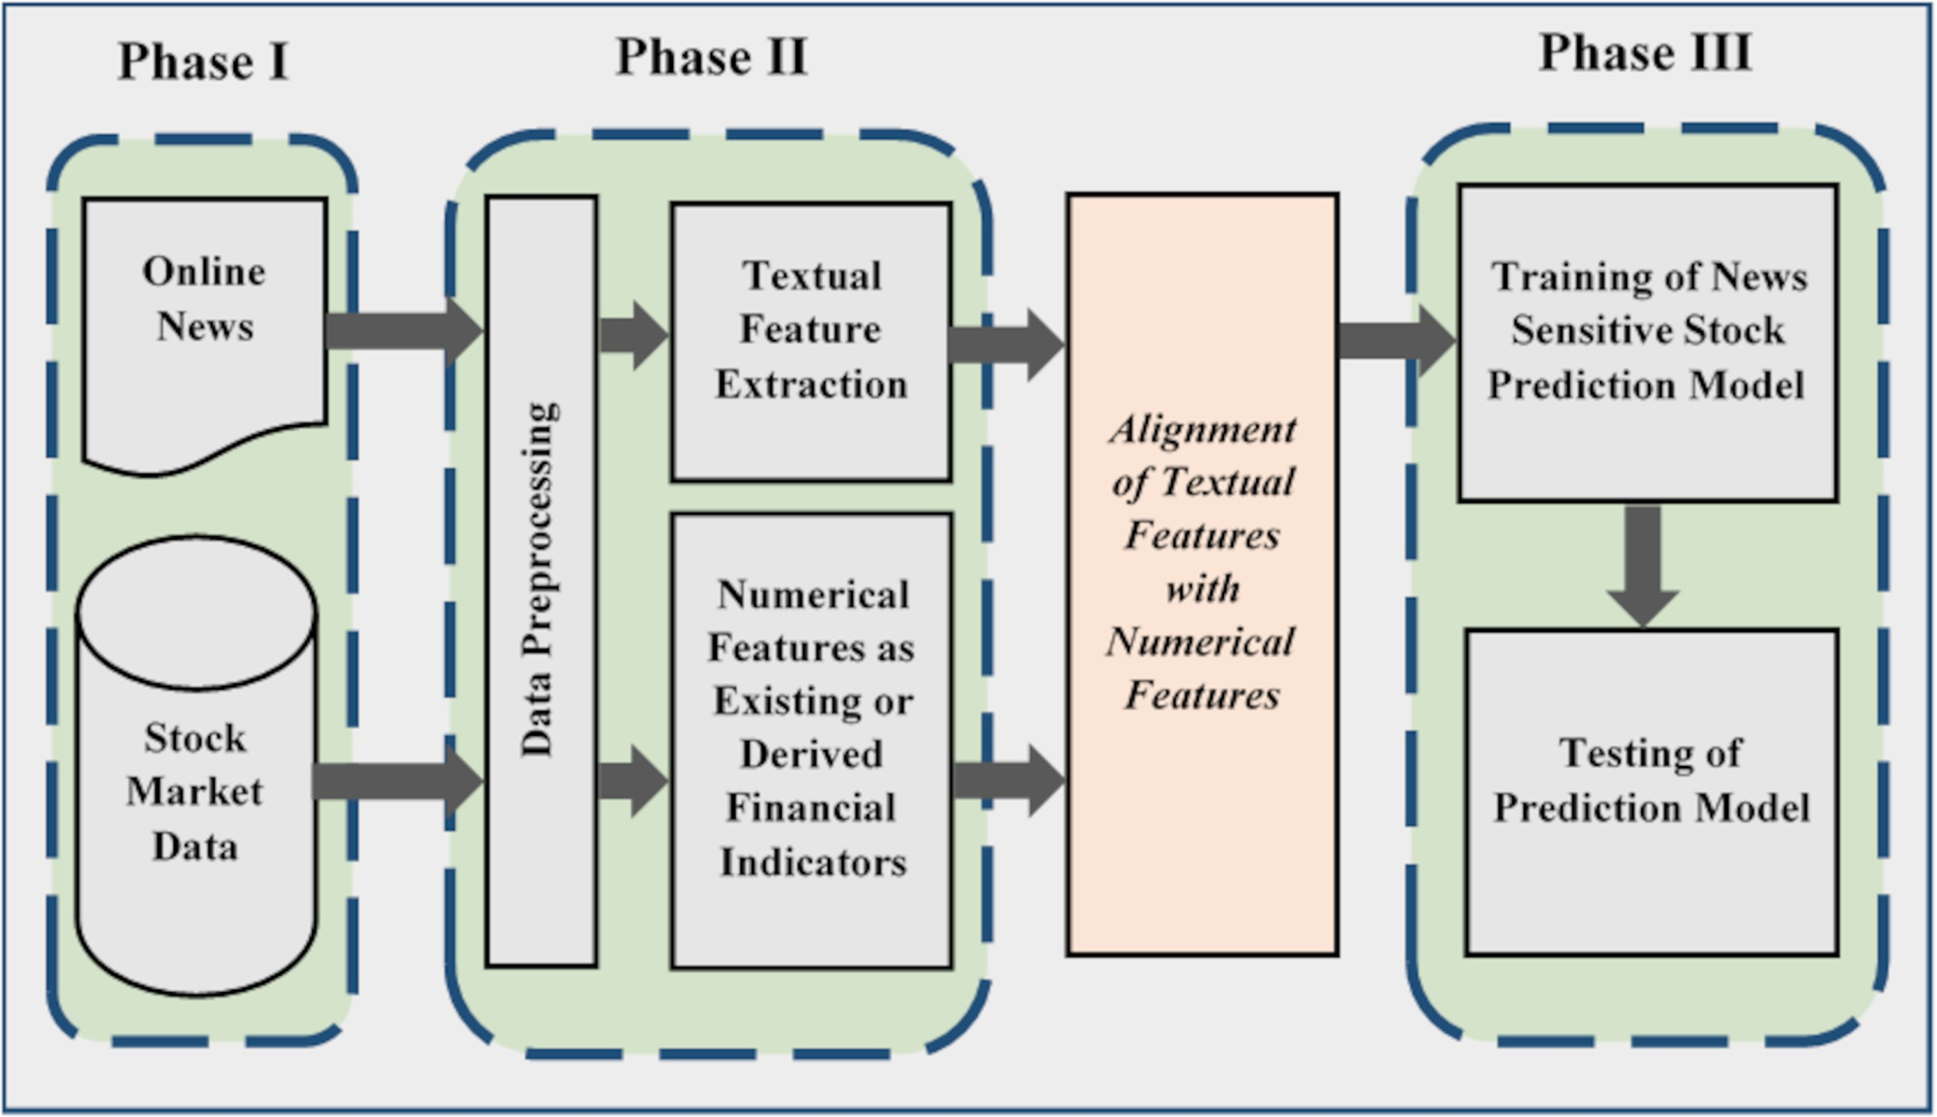
Generic methodology for news sensitive stock trend prediction

Slide 17
Step1: Raw Stock Price Dataset: Day-wise past stock prices of selected companies are collected fromthe BSE (Bombay Stock Exchange) official website.
Step2: Pre-processing: This step incorporates the following:
a) Data discretization: Part of data reduction but with particular importance, especially for numerical data
b) Data transformation: Normalization.
c) Data cleaning: Fill in missing values.
d) Data integration: Integration of data files. After the dataset is transformed into a clean dataset, the dataset is divided into training and testing sets so as to evaluate. Creating a data structure with 60 timesteps and 1 output.
Step3: Feature Selection: In this step, data attributes are chosen that are going to be fed to the neural network. In this study Date & Close Price are chosen as selected features.
Step 4: Train the NN model: The NN model is trained by feeding the training dataset. The model s initiated using random weights and biases. Proposed LSTM model consists of a sequential input layer
followed by 3 LSTM layers and then a dense layer with activation. The output layer again consists ofa dense layer with a linear activation function.
Step5: Output Generation: The RNN generated output is compared with the target values and error difference is calculated. The Backpropagation algorithm is used to minimize the error difference byadjusting the biases and weights of the neural network.
Step 6: Test Dataset Update: Step 2 is repeated for the test data set.
Step 7: Error and companies’ net growth calculation: By calculating deviation we check thepercentage of error of our prediction with respect to actual price.
Step 8: Visualization: Using Keras[21] and their function APIs the prediction is visualized.
Step 9: Investigate different time interval: We repeated this process to predict the price at different time intervals. For our case, we took 2-month dataset as training to predict 3-month, 6-month, 1 year & 3 years of close price of the share. In this different time span, we calculate the percentage of error in the future prediction. This would be different for different sectors. So, this will help to find a framefor the particular sector to predict future companies’ net growth.

Slide 18
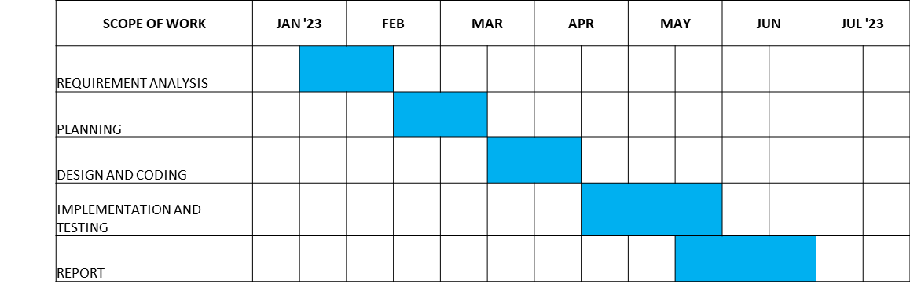
PLAN OF ACTION
Task | Due Date | Outcome | Challenges faced/Comments
REQUIREMENT ANALYSIS | 20th february 2023 | Finished Successfully | Referring to various base papers, checking plagiarism and grammatical errors in the paper.
PLANNING | Date Unknown | Finished successfully
DESIGN AND CODING | Date Unknown | To be done | Perform various tasks in order to complete project work.
IMPLEMENTATION AND TESTING | Date Unknown | To be done
REPORT SUBMISSION | Date Unknown | To be done

Slide 19
DATA SET
historical data downloaded from the Internet
Kaggle data set dataset_kaggle_stock
we downloaded live datasets namely google, nifty, reliance, etc.
from the Yahoo Finance website (https://finance.yahoo.com/)
Independent Fea- tures | Indicator Used | Date Range | Data Source
Gold Prices | Comex 100oz Gold Price -Chicago Mercantile Exchange (Gold) | 29 Dec 2006 to 28 June 2022 | Public Domain
Fuel Prices | Brent Crude Oil Benchmark (Brent) | 29 Dec 2006 to 28 June 2022 | Public Domain
Bond Yields | 10 year Govt. of In- dia Bond Yield (G-Sec) | 29 Dec 2006 to 28 June 2022 | Public Domain
Exchange Rate | USD-INR Exchange Rate | 29 Dec 2006 to 28 June 2022 | Public Domain
Sentiment Data | News from websites related to stocks in consideration viz., Reliance, SBI, HDFC Bank and TCS | 1 June 2019 to 28 June 2022 | Public Domain web- sites like BSE, India Today,Reuters, News18, Hindustan Times, Mint, Global Filings etc.
Dependent Variable Close Price | Close prices are considered – National Stock Exchange price | 29 Dec 2006 to 28 June 2022 | Yahoo Finance

Slide 20
TOOL/PLATFORM USED
Hardware Requirements:
• RAM: 4 GB
• Storage: 500 GB
• CPU: 2 GHz or faster
• Architecture: 32-bit or 64-bit
Software Requirements:
• Python 3.5 in Google Colab is used for data pre-processing, model training and
prediction.
• Operating System: windows 7 and above or Linux based OS or MAC OS

Slide 21
Conclusion
In this project, we are predicting closing stock price of any given organization, we developed a web application for predicting close stock price using LMS and LSTM algorithms for prediction. We have applied datasets belonging to Google, Nifty50, TCS, Infosys and Reliance Stocks and achieved above 95% accuracy for these datasets
This paper presents an extensive study of stock trend prediction using news and stock prices. It presents a generic approach to implement news sensitive stock prediction model and identifies three main phases. In each phase, challenges are identified and in search of opportunities existing literature is reviewed.

Slide 22
REFERENCES
[1] Bing, L., Chan, K. C. C., & Ou, C. Public sentiment analysis in twitter data for prediction of a company’s stock price movements. 2014 IEEE 11th International Conference on E- Business Engineering. IEEE. (2014).
[2] Bollen, J., Mao, H., & Zeng, X. Twitter mood predicts the stock market. Journal of Compu- tational Science, 2(1), 1–8. (2011).
[3] Chen. R and Lazer. M., Sentiment Analysis of Twitter Feeds for the Prediction of Stock Market Movement, Cs 229, pp. 15. (2011).
[4] Dogan, E., & Kaya, B. Deep learning based sentiment analysis and text summarization in social networks. 2019 International Artificial Intelligence and Data Processing Symposium (IDAP). IEEE. (2019).
[5] Kilimci, Z. H., & Akyokus, S. The analysis of text categorization represented with word embeddings using homogeneous classifiers. 2019 IEEE International Symposium on INnovations in Intelligent Systems and Applications (INISTA). IEEE.(2019).

Slide 23
[6] James Briggs. Sentiment Analysis for Stock Price Prediction. https://towardsdatascience.com/sentiment-analysis-for-stock-price-prediction in-python-bed40c65d178, last ac- cessed 2020.
[7]
    Li X, Wu P, Wang W. 2020. Incorporating stock prices and news sentiments for stock market prediction: a case of Hong Kong. Information Processing & Management 57(5):102212
[8]
    Liang X, Ge Z, Sun L, He M, Chen H. 2019. LSTM with wavelet transform based data preprocessing for stock price prediction. Mathematical Problems in Engineering 2019:1-8
[9]
Li, X., Wu, P., & Wang, W. Incorporating stock prices and news sentiments for stock market prediction: A case of Hong Kong. Information Processing & Management, 57(5), 102212. (2020).

Slide 24


